Slide 1


The object and subject of research.
Research relevance.
Prof. Darya Alontseva
School of IT and IS
D. Serikbayev East-Kazakhstan Technical University (EKTU),
Ust-Kamenogorsk (Oskemen), dalontseva@ektu.kz, dalontseva@mail.ru

Slide 2


Content
The definition of object and subject of research
How to define the object and subject of research?
Relevance of Research
Learning Outcomes
References

Slide 3


3 main steps of working on any research paper
1 - choosing a topic (an issue you are personally interested in).
- figuring out what the object and subject of research are
- gathering all vital information to be able to support all your arguments.

Slide 4

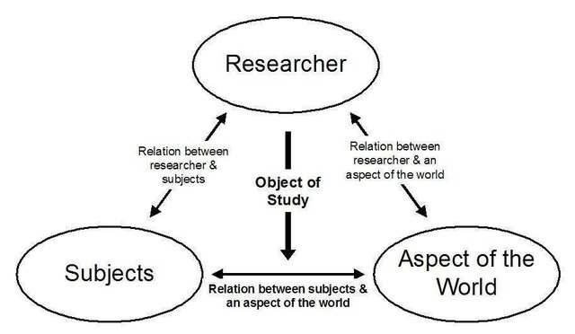
Object and Subject of Research
The object of research is a thing or phenomenon that can be observed or measured.
The subject of research is a category, a model or an idea.

Slide 5

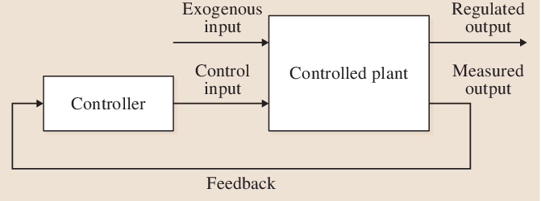
Examples
If you want to analyze a social media platform, such as facebook, the object of research will be posts written by its users. The subject of research are the topics of those posts.
.
If you want to automate some technological process, then the object could be this process, and the subject could be a model (algorithm) of its control.
https://www.semanticscholar.org/paper/Control-Theory-for-Automation%3A-Fundamentals-Isidori/46d5b576c2849264db200eae2f49865842a0c6ff

Slide 6

How to define the object and subject of research?
- analyze the topic you have chosen to research in detail
- think about the subject you want to study in detail, as well as the tools which you are going to use.
If you have metrics with the help of which you can measure this phenomenon, they will be the object of research while the issue in general will be the subject.

Slide 7
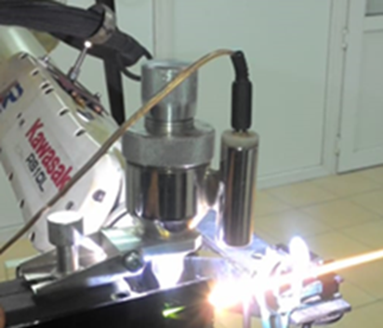
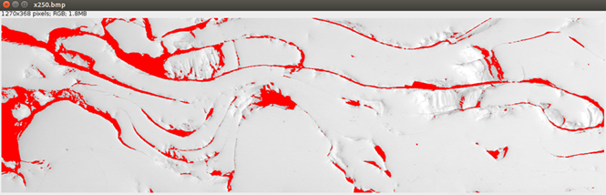
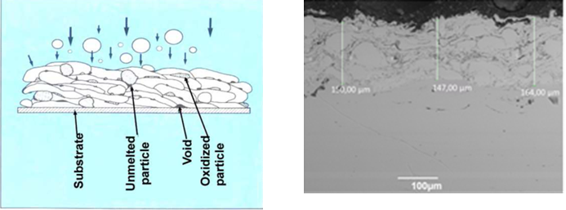
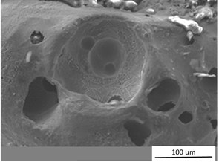
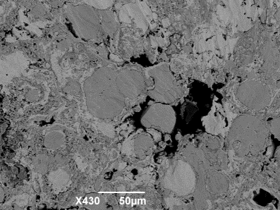
Examples
Title “Microplasma spraying of Ti coatings with desired structure and properties”
The object of this research is a microplasma spayed Ti coating and its structure (porosity, surface roughness) and properties (adhesion to substrate, microhardness) – measurable
The subject of this research is influence of spraying parameters on the structure and properties of the coating (the model).
Parameters/Settings
Electric current I, A | Plasma gas flow rate Q, slpm | Spraying distance H, мм | Wire flow rate Vw, m/min

Slide 8

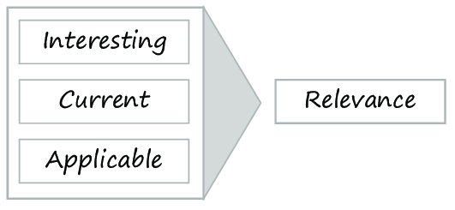
What is Research Relevance?
Research in applied fields has to be responsive to the needs of business and industry to make it useful and practicable for them.
For an article to be relevant it should be
1) interesting
2) applicable
3) current (to the needs of the practitioners)
4) written in an accessible and simple style

Slide 9
How do you know if your research is relevant?
Read widely the relevant articles on the topic.
Check out government policies to support research.
(you can find some useful links in your syllabus)
Explore the website of your university (the science and innovation section)
Ask your research advisor (consult, suggest your ideas!)
Participate in research in your department

Slide 10

Example of the rationale for the relevance
government priorities
The topic of the thesis "Title of the master's thesis" corresponds to one of the 10 priority areas of science development for 2021 - 2023, approved by the Supreme Scientific and Technical Commission of the Republic of Kazakhstan on April 29, 2020 (https://nauka.kz/page.php?page_id=16&lang=1&news_id=8791), namely the priority "Information, communication and space technologies”
current state of affairs
In recent years (or currently, or nowadays), research on the application of nonlinear control of a multi-link robotic arm has been in the focus of attention of researchers around the world, representing significant scientific and practical interest.
practice
Such robots are used for loading, painting, packing, etc.
straight to the point!
The development of algorithms for nonlinear control of a robotic manipulator for specific technological process is of great scientifical and practical importance.

Slide 11
Tips on the Title
Development is the process of developing or being developed
Development of new technology…
Design is a plan or drawing produced to show the look and function or workings of a building, a process or other object before it is built or made
Design of an information system for data processing

Slide 12

Learning Outcomes
be able to distinguish between the object and the subject of research;
be able to determine the relevance of the topic of scientific research;
know the structure of the research plan

Slide 13
References:
https://www.tastefulspace.com/blog/2020/07/17/object-and-subject-in-research-role/
https://www.researchgate.net/publication/339229809_Event_Handling_in_Business_Processes_--Flexible_Event_Subscription_for_Business_Process_Enactment/figures?lo=1
https://www.questionpro.com/blog/what-is-research/
https://en.wikipedia.org/wiki/Research_proposal
https://gradcoach.com/what-is-a-research-proposal-dissertation-thesis/
https://slideplayer.com/slide/9886823/
https://www.ahrq.gov/funding/process/grant-app-basics/esstplan.html
https://www.slideshare.net/mehwishshahid73/research-plan-31631062
Reference:

Slide 14


